Slide 1
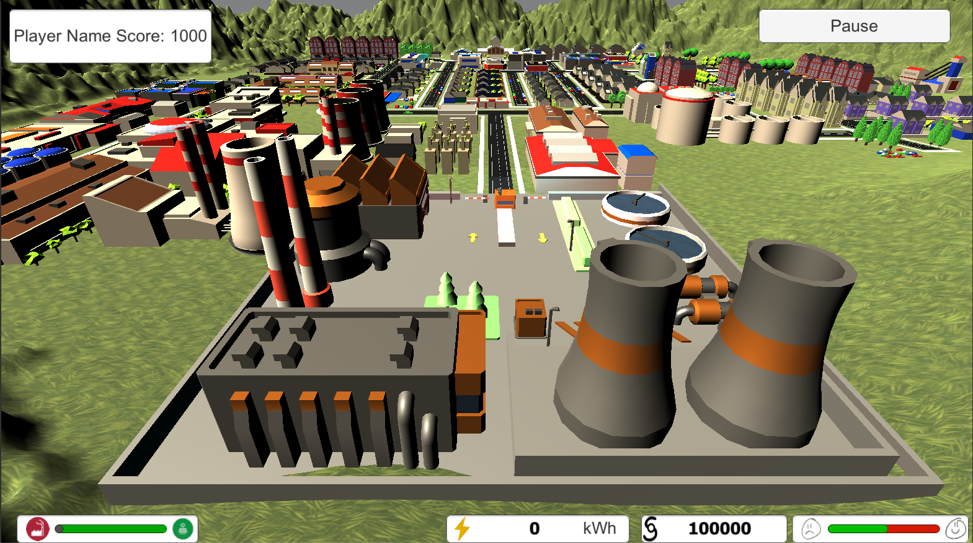
Player: Sam Score: 500

